Slide 1
Introduction to
Logistic Regression
Rachid Salmi,
Jean-Claude Desenclos,
Thomas Grein,
Alain Moren

Slide 2
Oral contraceptives (OC) and myocardial infarction (MI)
Case-control study, unstratified data
OC MI Controls OR
Yes 693 320 4.8
No 307 680 Ref.
Total 1000 1000

Slide 3
Oral contraceptives (OC) and myocardial infarction (MI)
Case-control study, unstratified data
Smoking MI Controls OR
Yes 700 500 2.3
No 300 500 Ref.
Total 1000 1000

Slide 4
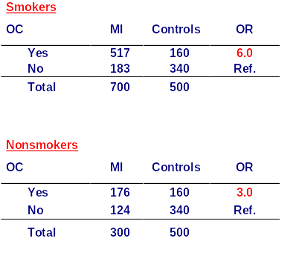
Odds ratio for OC adjusted for smoking = 4 .5

Slide 5
Cases of gastroenteritis among residents of a nursing home, by date of onset, Pennsylvania, October 1986
10
Number
of cases
One case
5
0
13
14
15
16
17
18
19
20
21
22
23
24
25
26
27
Days

Slide 6
Cases of gastroenteritis among residents of a nursing home according to protein supplement consumption, Pa, 1986
Protein Total Cases AR% RR
suppl.
YES 29 22 76 3.3
NO 74 17 23
Total 103 39 38

Slide 7
Sex-specific attack rates of gastroenteritis among residents of a nursing home, Pa, 1986
Sex Total Cases AR(%) RR & 95% CI
Male 22 5 23 Reference
Female 81 34 42 1.8 (0.8-4.2)
Total 103 39 38

Slide 8
Attack rates of gastroenteritis
among residents of a nursing home,
by place of meal, Pa, 1986
Meal Total Cases AR(%) RR & 95% CI
Dining room 41 12 29 Reference
Bedroom 62 27 44 1.5 (0.9-2.6)
Total 103 39 38

Slide 9
Age – specific attack rates of gastroenteritis among residents of a nursing home, Pa, 1986
Age group Total Cases AR(%)
50-59 1 2 50
60-69 9 2 22
70-79 28 9 32
80-89 45 17 38
90+ 19 10 53
Total 103 39 38

Slide 10
Attack rates of gastroenteritis among residents of a nursing home, by floor of residence, Pa, 1986
Floor Total Cases AR (%)
One 12 3 25
Two 32 17 53
Three 30 7 23
Four 29 12 41
Total 103 39 38

Slide 11
Multivariate analysis
Multiple models
  Linear regression
  Logistic regression
  Cox model
  Poisson regression
  Loglinear model
  Discriminant analysis
  ......
Choice of the tool according to the objectives,
the study, and the variables

Slide 12
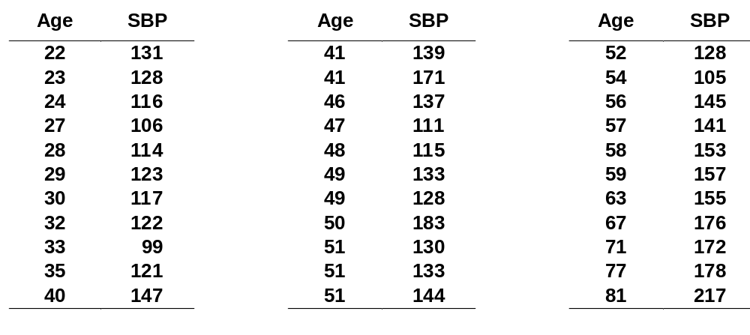
Simple linear regression
Table 1 Age and systolic blood pressure (SBP) among 33 adult women

Slide 13
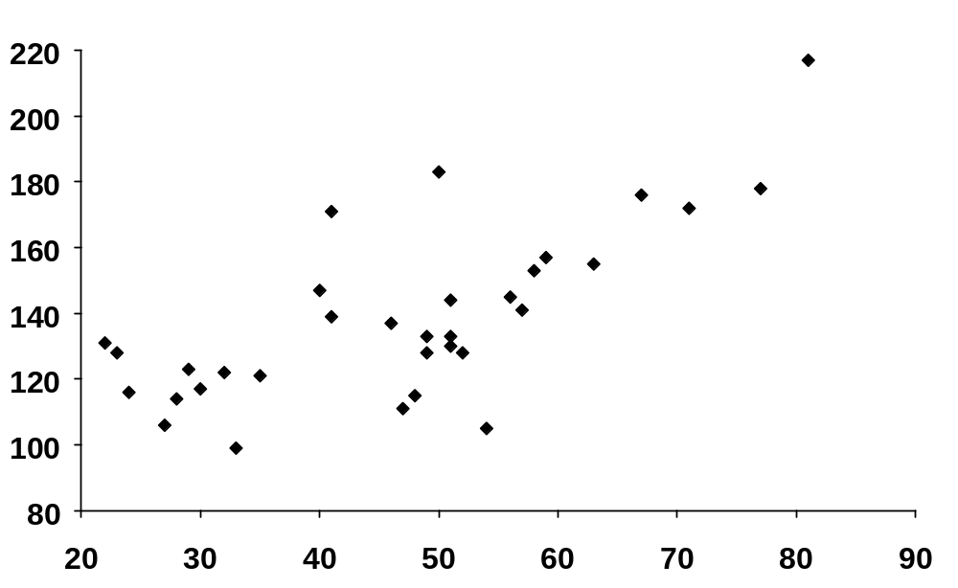
SBP (mm Hg)
Age (years)
  adapted from Colton T. Statistics in Medicine. Boston: Little Brown, 1974

Slide 14
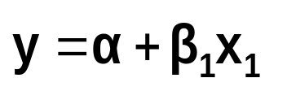
Simple linear regression
Relation between 2 continuous variables (SBP and age)
Regression coefficient β₁
  Measures association between y and x
  Amount by which y changes on average when x changes by one unit
  Least squares method
y
Slope
x

Slide 15

Multiple linear regression
Relation between a continuous variable and a set of
i continuous variables
Partial regression coefficients β_{i}
  Amount by which y changes on average
  when x_{i} changes by one unit
  and all the other x_{i}s remain constant
  Measures association between x_{i} and y adjusted for all other x_{i}
Example
  SBP versus age, weight, height, etc

Slide 16
Multiple linear regression
Predicted Predictor variables
Response variable Explanatory variables
Outcome variable Covariables
Dependent Independent variables

Slide 17
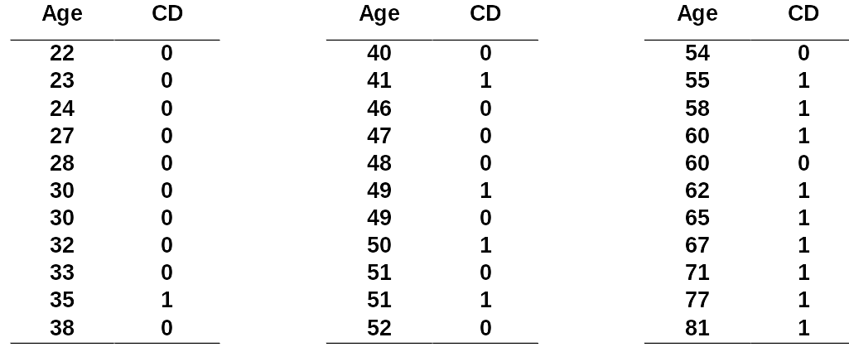
Logistic regression (1)
Table 2 Age and signs of coronary heart disease (CD)

Slide 18
How can we analyse these data?
Compare mean age of diseased and non-diseased
  Non-diseased: 38.6 years
  Diseased: 58.7 years (p<0.0001)
Linear regression?

Slide 19
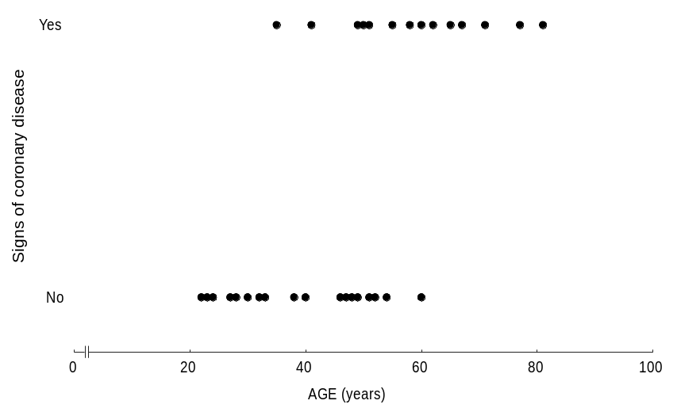
Dot-plot: Data from Table 2

Slide 20
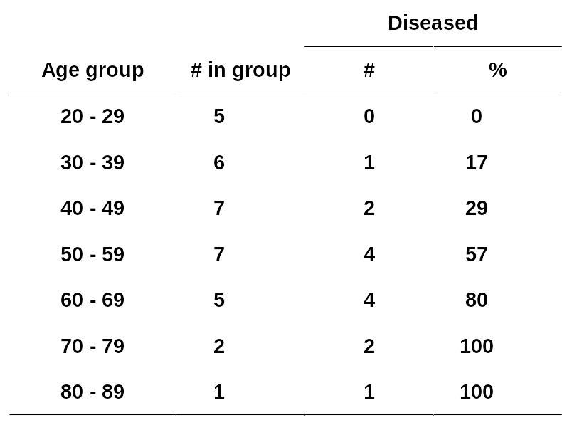
Logistic regression (2)
Table 3 Prevalence (%) of signs of CD according to age group

Slide 21
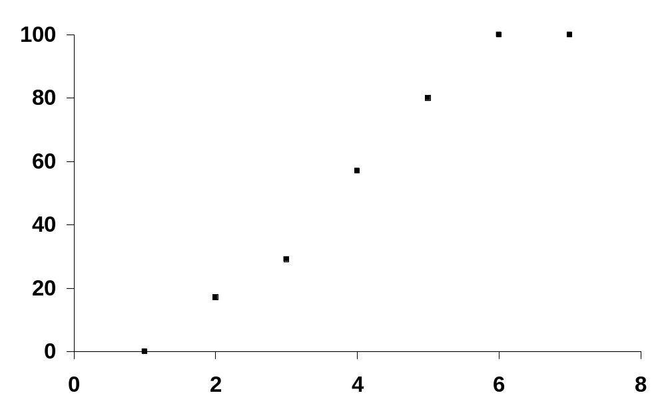
Dot-plot: Data from Table 3
Diseased %
Age group

Slide 22
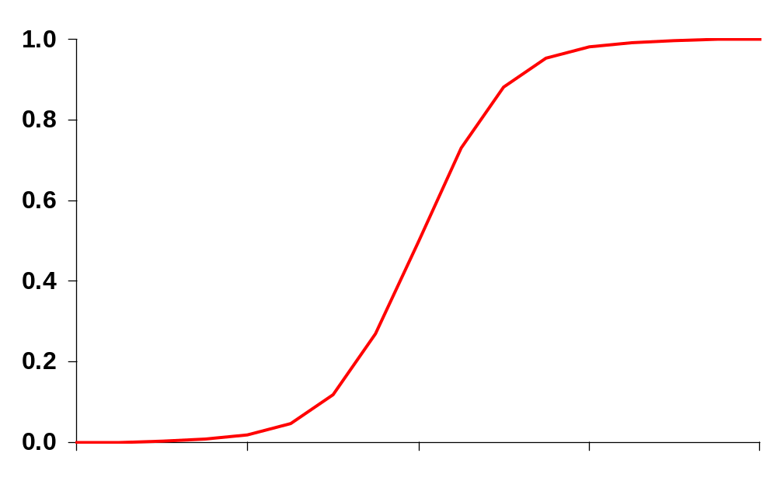
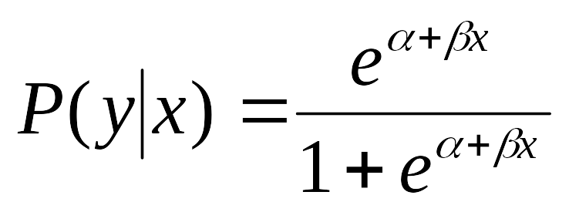
Logistic function (1)
Probability of disease
x

Slide 23

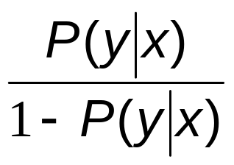
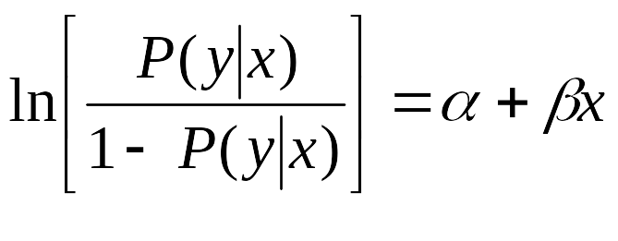
Transformation
α = log odds of disease
in unexposed
β = log odds ratio associated
with being exposed
e ^{β} = odds ratio
{
logit of P(y|x)

Slide 24
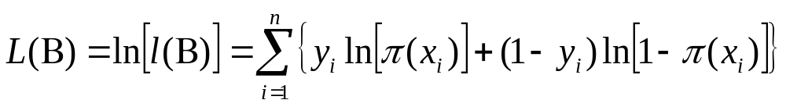
Fitting equation to the data
Linear regression: Least squares
Logistic regression: Maximum likelihood
Likelihood function
  Estimates parameters α and β
  Practically easier to work with log-likelihood

Slide 25
Maximum likelihood
Iterative computing
  Choice of an arbitrary value for the coefficients (usually 0)
  Computing of log-likelihood
  Variation of coefficients’ values
  Reiteration until maximisation (plateau)
Results
  Maximum Likelihood Estimates (MLE) for α and β
  Estimates of P(y) for a given value of x

Slide 26
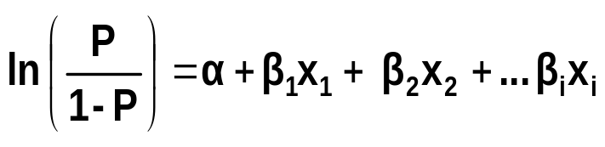
Multiple logistic regression
More than one independent variable
  Dichotomous, ordinal, nominal, continuous …
Interpretation of β_{i}
  Increase in log-odds for a one unit increase in x_{i} with all the other x_{i}s constant
  Measures association between x_{i} and log-odds adjusted for all other x_{i}

Slide 27
Statistical testing
Question
  Does model including given independent variable provide more information about dependent variable than model without this variable?
Three tests
  Likelihood ratio statistic (LRS)
  Wald test
  Score test

Slide 28
Likelihood ratio statistic
Compares two nested models
  Log(odds) = α + β₁x₁ + β₂x₂ + β₃x₃ (model 1)
  Log(odds) = α + β₁x₁ + β₂x₂ (model 2)
LR statistic
  -2 log (likelihood model 2 / likelihood model 1) =
  -2 log (likelihood model 2) minus -2log (likelihood model 1)
  LR statistic is a χ² with DF = number of extra parameters
  in model

Slide 29
Coding of variables (2)
Nominal variables or ordinal with unequal classes:
  Tobacco smoked: no=0, grey=1, brown=2, blond=3
  Model assumes that OR for blond tobacco
  = OR for grey tobacco³
  Use indicator variables (dummy variables)

Slide 30
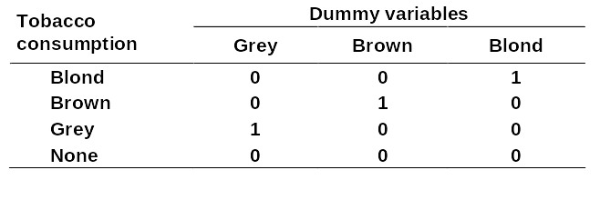
Indicator variables: Type of tobacco
Neutralises artificial hierarchy between classes in the variable "type of tobacco"
No assumptions made
3 variables (3 df) in model using same reference
OR for each type of tobacco adjusted for the others in reference to non-smoking

Slide 31
Reference
Hosmer DW, Lemeshow S. Applied logistic regression. Wiley & Sons, New York, 1989

Slide 32
Logistic regression
Synthesis

Slide 33
Salmonella enteritidis
Sex
Floor
Age
Place of meal
Blended diet
S. Enteritidis
gastroenteritis
Protein supplement

Slide 34
Unconditional Logistic Regression
Term
Odds Ratio
95%
C.I.
Coef.
S. E.
Z-Statistic
P-Value
AGG (2/1)
1,6795
0,2634
10,7082
0,5185
0,9452
0,5486
0,5833
AGG (3/1)
1,7570
0,3249
9,5022
0,5636
0,8612
0,6545
0,5128
Blended (Yes/No)
1,0345
0,3277
3,2660
0,0339
0,5866
0,0578
0,9539
Floor (2/1)
1,6126
0,2675
9,7220
0,4778
0,9166
0,5213
0,6022
Floor (3/1)
0,7291
0,0991
5,3668
-0,3159
1,0185
-0,3102
0,7564
Floor (4/1)
1,1137
0,1573
7,8870
0,1076
0,9988
0,1078
0,9142
Meal
1,5942
0,4953
5,1317
0,4664
0,5965
0,7819
0,4343
Protein (Yes/No)
9,0918
3,0219
27,3533
2,2074
0,5620
3,9278
0,0001
Sex
1,3024
0,2278
7,4468
0,2642
0,8896
0,2970
0,7665
CONSTANT
*
*
*
-3,0080
2,0559
-1,4631
0,1434

Slide 35
Unconditional Logistic Regression
Term
Odds Ratio
95%
C.I.
Coefficient
S. E.
Z-Statistic
P-Value
Age
1,0234
0,9660
1,0842
0,0231
0,0294
0,7848
0,4326
Blended (Yes/No)
1,0184
0,3220
3,2207
0,0183
0,5874
0,0311
0,9752
Floor (2/1)
1,6440
0,2745
9,8468
0,4971
0,9133
0,5443
0,5862
Floor (3/1)
0,7132
0,0972
5,2321
-0,3379
1,0167
-0,3324
0,7396
Floor (4/1)
1,0708
0,1522
7,5322
0,0684
0,9953
0,0687
0,9452
Meal
1,6561
0,5236
5,2379
0,5045
0,5875
0,8587
0,3905
Protein (Yes/No)
8,7678
2,9521
26,0403
2,1711
0,5554
3,9091
0,0001
Sex
1,1957
0,2135
6,6981
0,1787
0,8791
0,2033
0,8389
CONSTANT
*
*
*
-4,2896
2,8908
-1,4839
0,1378

Slide 36
Logistic Regression Model Summary Statistics
Value DF p-value
Deviance 107,9814 95
Likelihood ratio test 34,8068 8 < 0.001
Parameter Estimates 95% C.I.
Terms Coefficient Std.Error p-value OR Lower Upper
%GM -1,8857 1,0420 0,0703 0,1517 0,0197 1,1695
SEX ='2' 0,2139 0,8812 0,8082 1,2385 0,2202 6,9662
FLOOR ='2' 0,4987 0,9083 0,5829 1,6466 0,2776 9,7659
²FLOOR ='3' -0,3235 1,0150 0,7500 0,7236 0,0990 5,2909
FLOOR ='4' 0,1088 0,9839 0,9119 1,1150 0,1621 7,6698
MEAL ='2' 0,5308 0,5613 0,3443 1,7002 0,5659 5,1081
Protein ='1' 2,1809 0,5303 < 0.001 8,8541 3,1316 25,034
TWOAGG ='2' 0,1904 0,5162 0,7122 1,2098 0,4399 3,3272
Termwise Wald Test
Term Wald Stat. DF p-value
FLOOR 1,0812 3 0,7816

Slide 37
Poisson Regression Model
Summary Statistics
Value DF p-value
Deviance 60,2622 95
Likelihood ratio test 67,7378 8 < 0.001
Parameter Estimates 95% C.I.
Terms Coefficient Std.Error p-value RR Lower Upper
%GM -1,8213 0,8446 0,0310 0,1618 0,0309 0,8471
SEX ='2' 0,1295 0,7106 0,8554 1,1383 0,2827 4,5828
FLOOR ='2' 0,2503 0,6867 0,7154 1,2844 0,3344 4,9343
FLOOR ='3' -0,1422 0,8032 0,8595 0,8674 0,1797 4,1877
FLOOR ='4' 0,1368 0,7263 0,8506 1,1466 0,2761 4,7608
MEAL ='2' 0,2373 0,3854 0,5381 1,2678 0,5956 2,6987
Protein ='1' 1,0658 0,3413 0,0018 2,9032 1,4871 5,6679
TWOAGG ='2' 0,0645 0,3682 0,8611 1,0666 0,5182 2,1951
Termwise Wald Test
Term Wald Stat. DF p-value
FLOOR 0,4178 3 0,9365

Slide 38
Cox Proportional Hazards
Term | Hazard Ratio | 95% | C.I. | Coefficient | S. E. | Z-Statistic | P-Value
_AGG (2/1) | 1,0666 | 0,5183 | 2,195 | 0,0645 | 0,3682 | 0,175 | 0,8611
Floor(2/1) | 1,2844 | 0,3344 | 4,9342 | 0,2503 | 0,6867 | 0,3646 | 0,7154
Floor(3/1) | 0,8674 | 0,1797 | 4,1876 | -0,1422 | 0,8032 | -0,177 | 0,8595
Floor(4/1) | 1,1466 | 0,2761 | 4,7607 | 0,1368 | 0,7263 | 0,1883 | 0,8506
Meal (2/1) | 1,2678 | 0,5957 | 2,6986 | 0,2373 | 0,3854 | 0,6157 | 0,5381
Protein(Yes/No) | 2,9032 | 1,4871 | 5,6678 | 1,0658 | 0,3413 | 3,1225 | 0,0018
Sex (2/1) | 1,1383 | 0,2827 | 4,5827 | 0,1295 | 0,7106 | 0,1822 | 0,8554
Convergence: | Converged
Iterations: | 5
-2 * Log-Likelihood: | 346,0200
Test | Statistic | D.F. | P-Value
Score | 17,1727 | 7 | 0,0163
Likelihood Ratio | 15,4889 | 7 | 0,0302

